Slide 1
Digital Fundamentals
Number Systems, Operations, and Codes

Slide 2
Number Systems

Slide 3

Decimal Numbers
The decimal number system has ten digits: 0, 1, 2, 3, 4, 5, 6, 7, 8, and 9
The decimal numbering system has a base of 10 with each position weighted by a factor of 10:

Slide 4
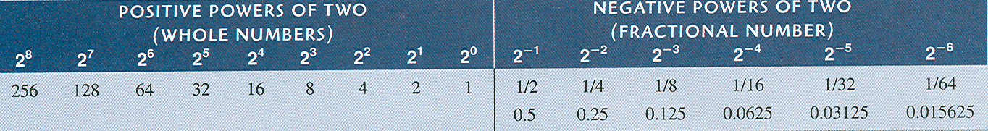
Binary Numbers
The binary number system has two digits:
0 and 1
The binary numbering system has a base of 2 with each position weighted by a factor of 2:

Slide 5
Decimal-to-Binary Conversion

Slide 6
Decimal-to-Binary Conversion
Sum-of-weights method
Repeated division-by-2 method
Conversion of decimal fractions to binary

Slide 7
Binary Arithmetic

Slide 8
Binary Arithmetic
Binary addition
Binary subtraction
Binary multiplication
Binary division

Slide 9
Complements of Binary Numbers

Slide 10
Complements of Binary Numbers
1’s complements
2’s complements

Slide 11
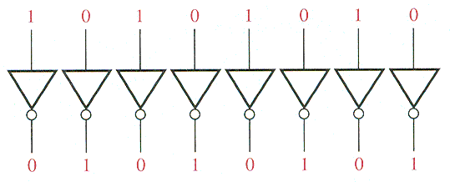
Complements of Binary Numbers
1’s complement

Slide 12
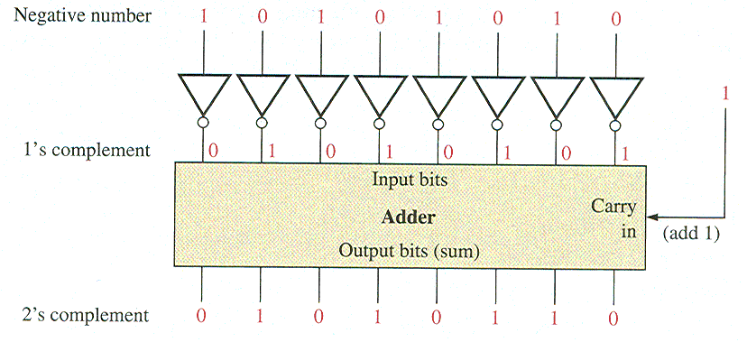
Complements of Binary Numbers
2’s complement

